Slide 1

EY GDS Hackpions 4.0
Prototype Submission Phase

Slide 2
MEMBER DETAILS
Bibin Philip Sam
Software Consultant
Web development using .NET framework
THEME:
Smart Dashboard Editor

Slide 3
PROBLEM STATEMENT
There is a demand for a faster and smarter way to update from a visualization tool used across the board; a user-friendly way to update the underlying data connected to any visualization platform without switching between many tools.
Generally the reporting tools do not allow modifying data in the source as they are read-only.

Slide 4
SOLUTION
The write-back function in Power Apps is able to support this scenario. Write-back enables end users to change and update the values in the data source directly from the Power BI report.
Points to remember
1. A Power Apps license is required.
2. To do write-back, the connection with the data source should be done by DirectQuery mode as the results will be immediately noticed without a hard refresh on the Power BI dataset.
3. The data table must have a primary key field in order to update the selected records and fields with DirectQuery mode.

Slide 5
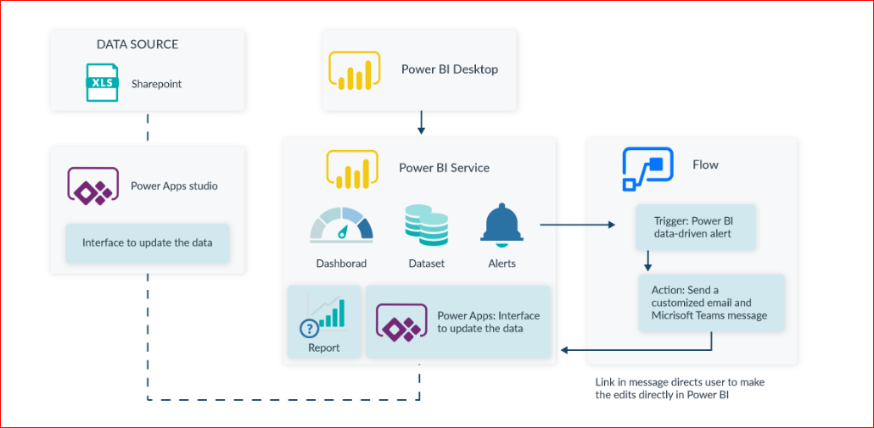
Architecture Diagram

Slide 6
In the PowerBI, create a basic report having the database as the data source and publish it, which will be available in a workspace of the PowerBI Service.
The Power Apps tool in PowerBI enables us to create an app. It also directly uses the data source from the PowerBI, so the list controls, form controls automatically get binded. However, we can use “ThisItem” object to refer to our data table, and bind the forms controls with the fields of the data table. Making few of the fields editable, and any data operations like add, edit or delete performed will directly affect the data source. Write-back function in PowerApps enables end users to change and update the values in the data source. Due to the DirectQuery mode the report immediately reflects the updates, too.
A notification can also be sent to users to alert them of the changes.

Slide 7
WORKING PROTOTYPE
Youtube: https://youtu.be/fScUhEhmuaM
GitHub: https://github.com/bibinphilip/power-bi-update-record

Slide 8
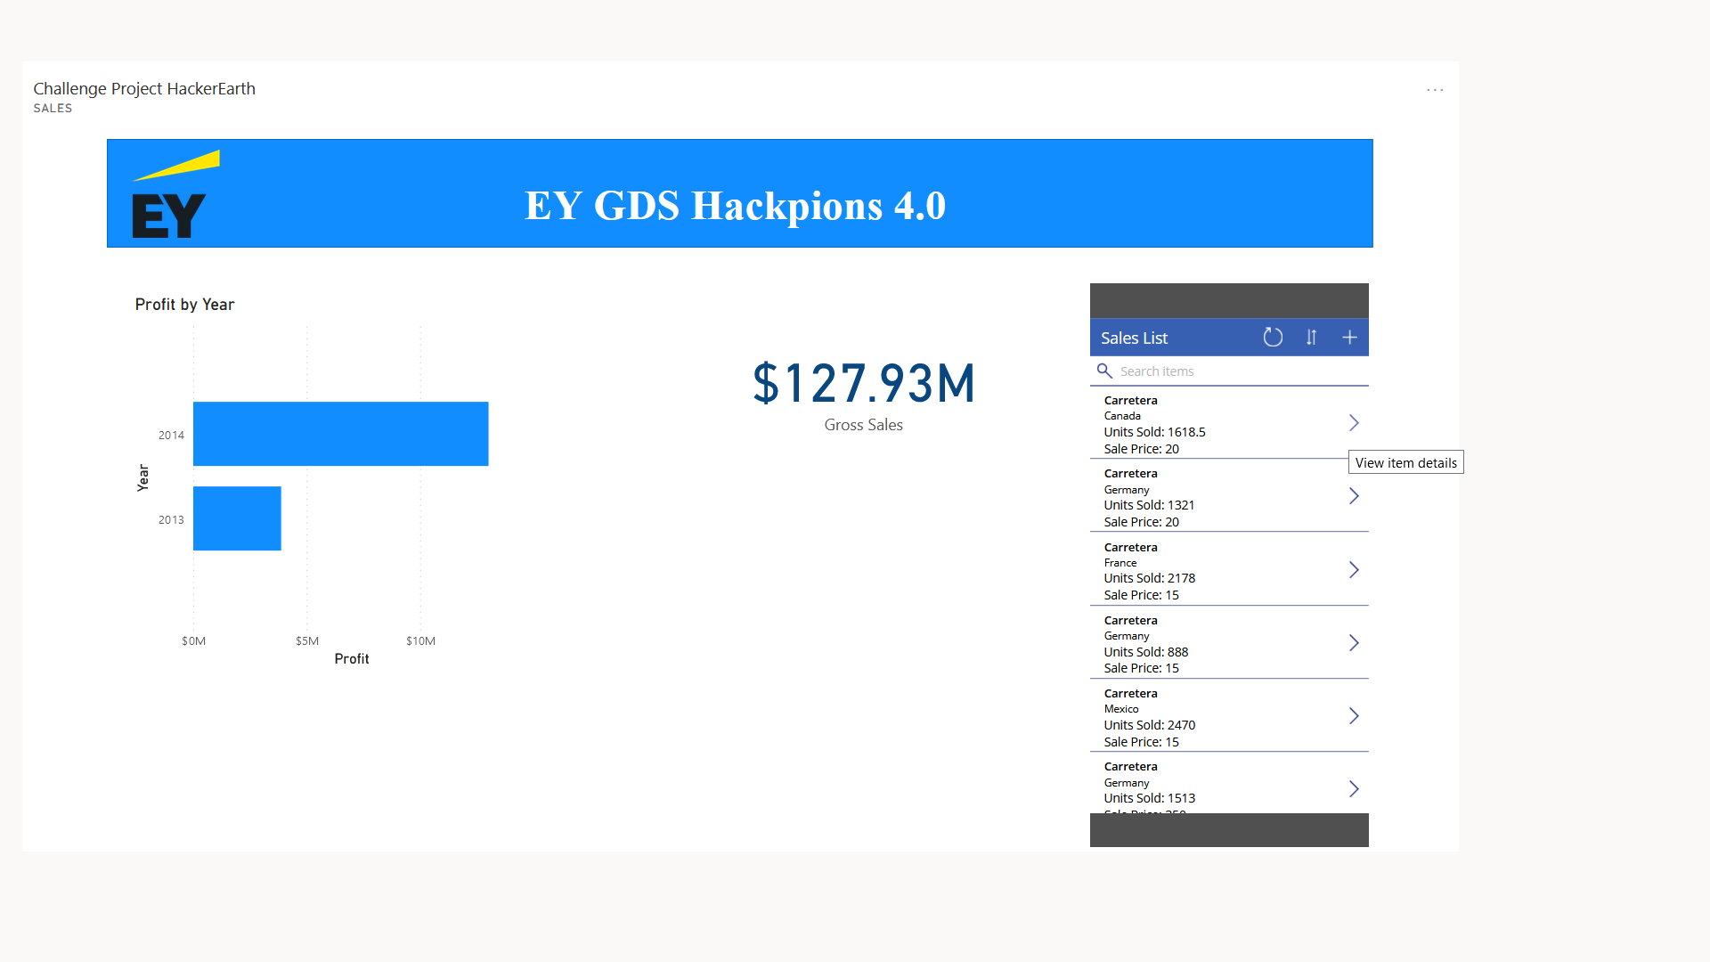
Collection of Sales data
Units sold is 1618.5
Gross Sales is $127.93M

Slide 9
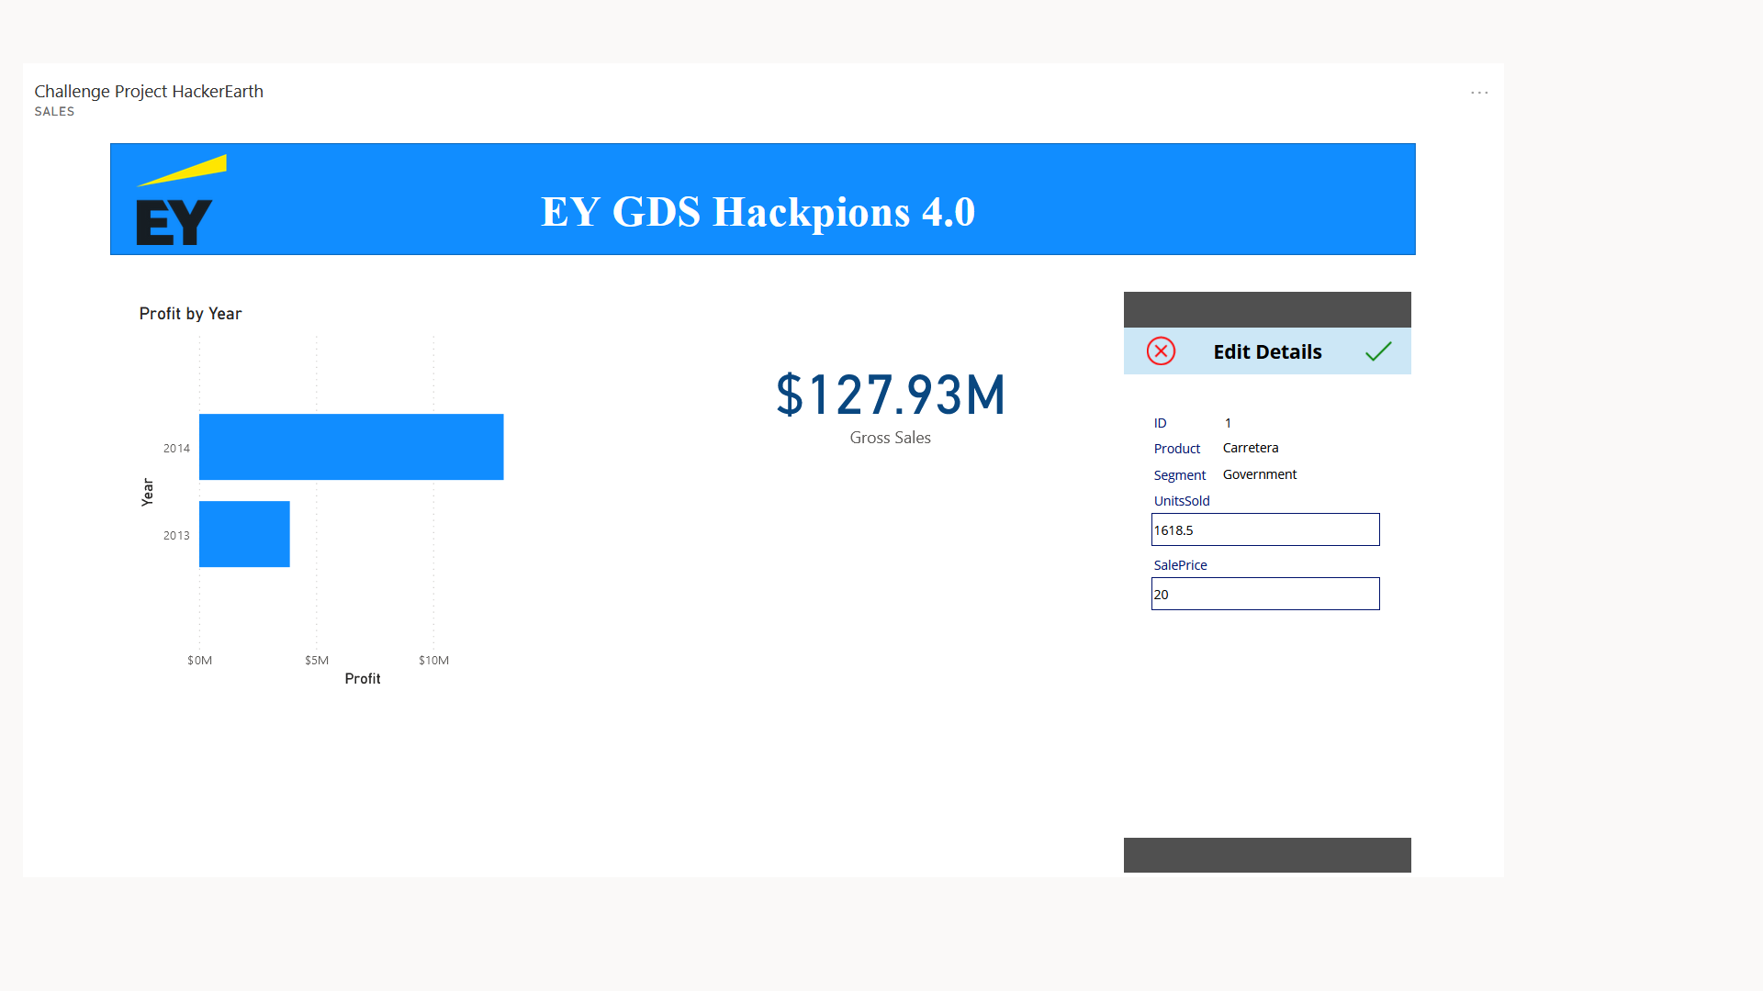
Edit Form with old value

Slide 10

Edit Form with new value

Slide 11

Updated Information
Units sold is 1800
Gross Sales is $127.94M

Slide 12
Thank you

